Slide 1
Lexicalization of PCFGs
The model of Charniak (1997)
Notes:
Should add a slide on parsing speech lattices!
Explain queries chart must support for efficiency:
Is edge X:[i,j] already in the chart?
What edges with label Y end at position i?
What edges with label Z start at position j?

Slide 2
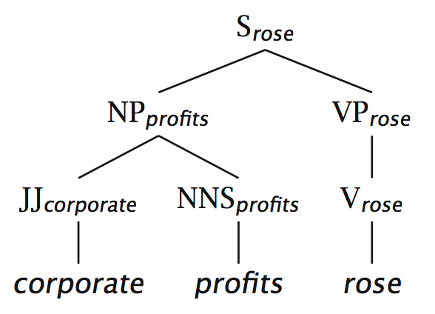
Charniak (1997)
A very straightforward model of a lexicalized PCFG
Probabilistic conditioning is “top-down” like a regular PCFG
But actual parsing is bottom-up, somewhat like the CKY algorithm we saw

Slide 3
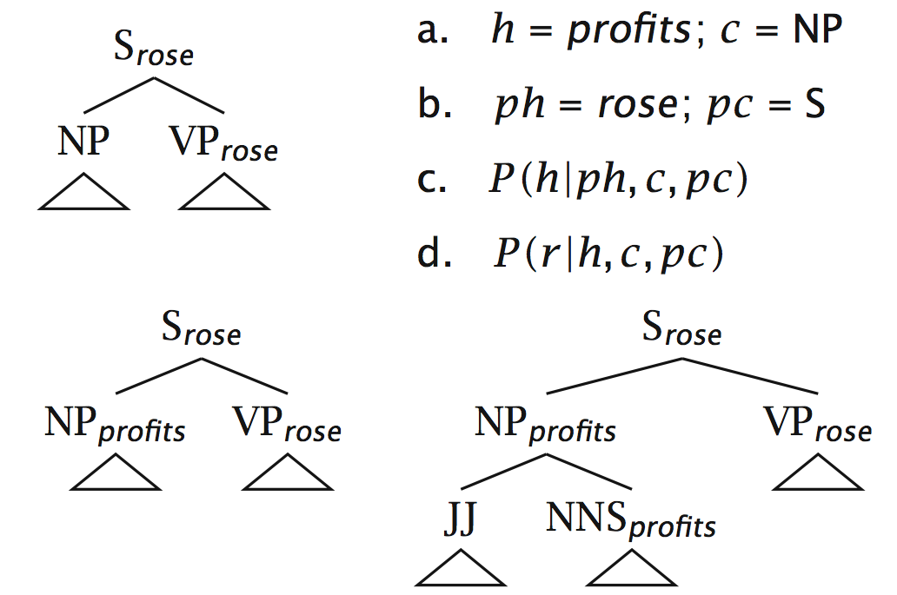
Charniak (1997) example

Slide 4
Lexicalization models argument selection by sharpening rule expansion probabilities
The probability of different verbal complement frames (i.e., “subcategorizations”) depends on the verb:
Local Tree | come | take | think | want
VP → V | 9.5% | 2.6% | 4.6% | 5.7%
VP → V NP | 1.1% | 32.1% | 0.2% | 13.9%
VP → V PP | 34.5% | 3.1% | 7.1% | 0.3%
VP → V SBAR | 6.6% | 0.3% | 73.0% | 0.2%
VP → V S | 2.2% | 1.3% | 4.8% | 70.8%
VP → V NP S | 0.1% | 5.7% | 0.0% | 0.3%
VP → V PRT NP | 0.3% | 5.8% | 0.0% | 0.0%
VP → V PRT PP | 6.1% | 1.5% | 0.2% | 0.0%
“monolexical” probabilities

Slide 5
Lexicalization sharpens probabilities: Predicting heads
“Bilexical probabilities”
P(prices | n-plural) = .013
P(prices | n-plural, NP) = .013
P(prices | n-plural, NP, S) = .025
P(prices | n-plural, NP, S, v-past) = .052
P(prices | n-plural, NP, S, v-past, fell) = .146
Notes:
Say that you clearly need to smooth!

Slide 6
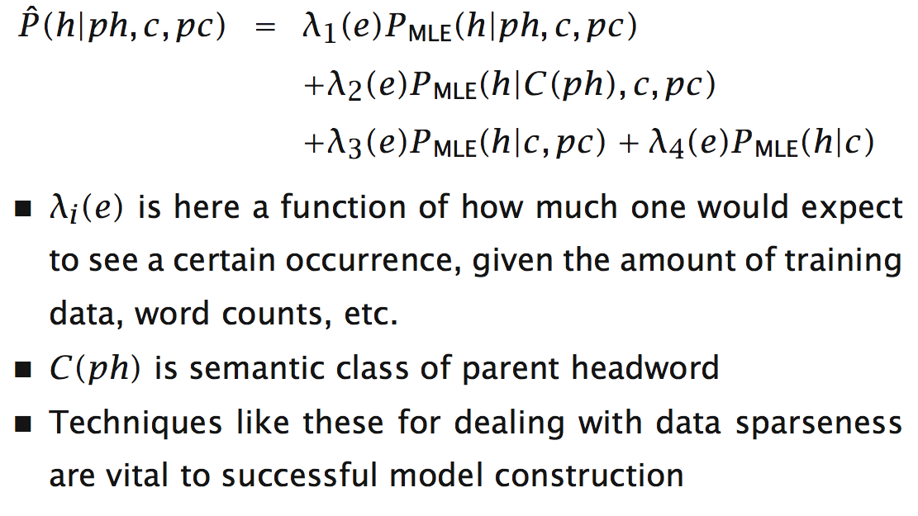
Charniak (1997) linear interpolation/shrinkage

Slide 7
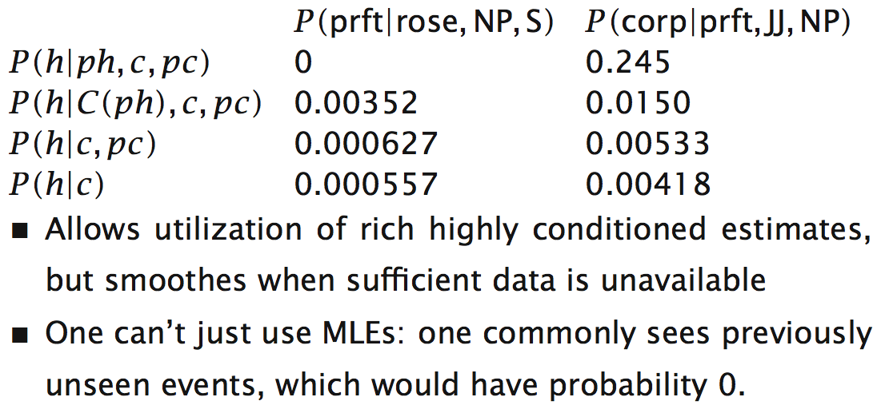
Charniak (1997) shrinkage example

Slide 8
Lexicalization of PCFGs
The model of Charniak (1997)
Notes:
Should add a slide on parsing speech lattices!
Explain queries chart must support for efficiency:
Is edge X:[i,j] already in the chart?
What edges with label Y end at position i?
What edges with label Z start at position j?

